Slide 1
Neuro-Informatics: Integrating Deep Learning for Brain Image Analysis in Neurological Disorders
Submitted in the partial fulfillment for the award of the degree of
BACHELOR OF ENGINEERING
IN
AIML
Submitted by:
RAGHAV BHATIA-20BCS6371
HARDIK SHARMA-20BCS6355
ISHAL WALIA-20BCS6414
Under the Supervision of:
Mrs. Priyanka Kaushik
Department of AIT-CSE
DISCOVER . LEARN . EMPOWER

Slide 2
Outline
Introduction to Project
Problem Formulation
Objectives of the work
Methodology used
Results and Outputs
Conclusion
Future Scope
References

Slide 3
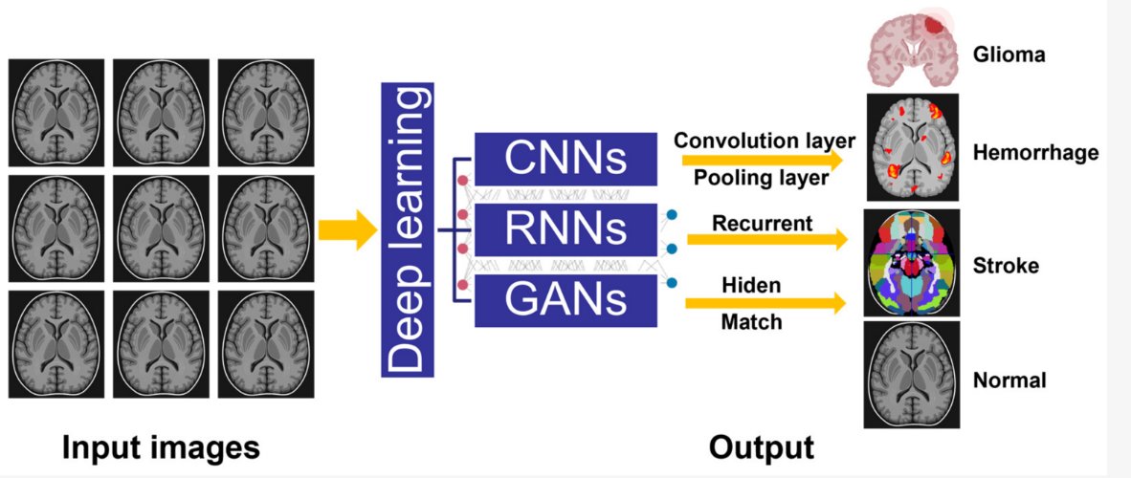
The primary objective of the project is to develop and integrate deep learning techniques into neuroinformatics workflows for more efficient and accurate analysis of brain images in neurological disorders
But why do we need it ?
Neuro-informatics, integrating deep learning for brain image analysis in neurological disorders, is essential for revolutionizing diagnosis and treatment.
Deep learning algorithms can accurately analyze complex brain images, enabling early detection of conditions like Alzheimer's and Parkinson's.
In essence, neuro-informatics with deep learning empowers precise diagnosis, timely intervention, and innovative research, ultimately enhancing patient care and outcomes in neurology.

Slide 4
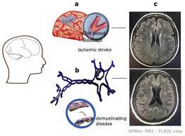
This technology facilitates personalized treatment plans, aids in drug development, and advances our understanding of neurological disorders by integrating diverse data sources
Neuro-informatics, through the integration of deep learning for brain image analysis in neurological disorders, holds immense significance. This integration enables personalized treatment plans, accelerates drug development, and advances our understanding of neurological disorders by synthesizing diverse data sources
The main goal of this project is to leverage neuro-informatics by integrating deep learning for improved brain image analysis in neurological disorders.

Slide 5
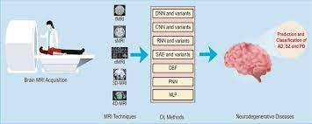
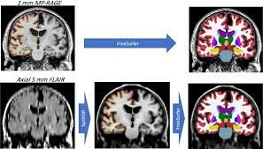
In summary, neuro-informatics with deep learning empowers clinicians with powerful tools to improve patient care, drive research, and ultimately enhance outcomes in neurology.
Enables more accurate and timely detection of neurological disorders like Alzheimer's and Parkinson's through advanced brain image analysis.
Drives progress in understanding neurological disorders by integrating diverse data sources and enabling the exploration of novel insights through deep learning techniques.

Slide 6
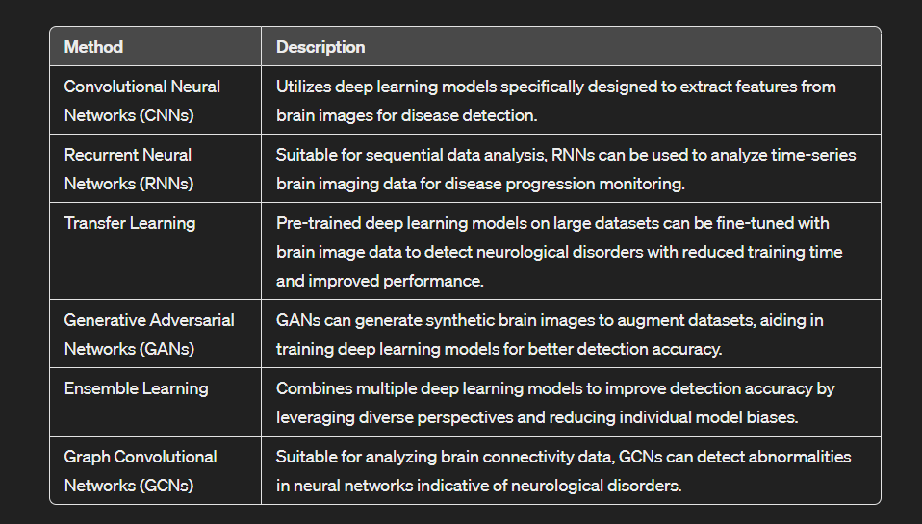
Possible Methods For Detection

Slide 7
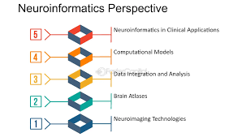
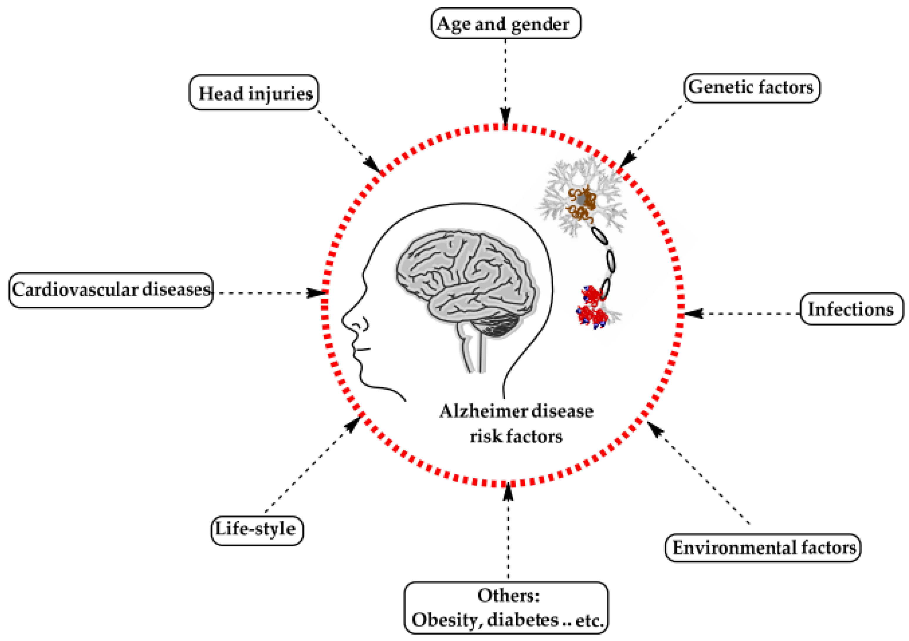
The Need Of The Hour
Early Diagnosis: With the rising prevalence of neurological disorders, early diagnosis is crucial for effective treatment and management. Deep learning techniques can enable the early detection of these disorders by analyzing subtle changes in brain images, leading to better patient outcomes.
Neurological disorders often exhibit diverse manifestations and responses to treatment across individuals.
Deep learning allows for the identification of personalized biomarkers and patterns in brain images, facilitating the development of targeted and effective treatment strategies tailored to each patient's unique condition.

Slide 8

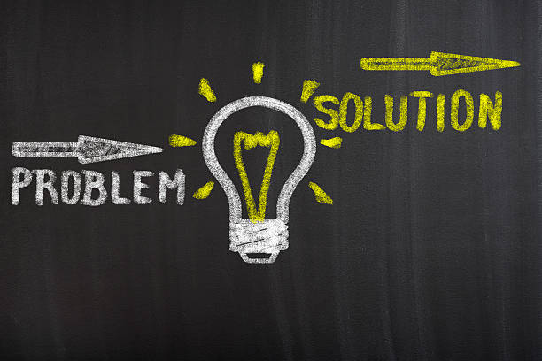
CONCLUSION
This Project will serve as a useful approach to automate pothole and accident detThe integration of deep learning techniques into neuro-informatics has shown significant promise in improving the accuracy and efficiency of diagnosing neurological disorders through brain image analysis.ection and reporting. It will enable to create and maintain updated database of detected potholes.
By identifying subtle patterns and biomarkers in brain images, this project enables the development of personalized treatment plans tailored to individual patients, leading to more effective interventions and better patient outcomes.

Slide 9
Future Scope
The future scope of "Neuro-Informatics: Integrating Deep Learning for Brain Image Analysis in Neurological Disorders", as there is a growing need for smart and efficient transportation systems in cities around the world. Here are some potential areas where these systems could have a significant impact:
Data Sharing and Collaboration: Collaboration between institutions and researchers is crucial for advancing neuro-informatics in neurological disorders. Future initiatives should promote data sharing and collaboration to enable the development of large-scale datasets and robust models that can generalize across diverse patient populations.
Clinical Implementation: There is a growing need to translate the advancements made in neuro-informatics and deep learning into clinical practice. Future efforts should focus on integrating these technologies into routine clinical workflows to aid healthcare professionals in the accurate diagnosis and treatment of neurological disorders.
Data Sharing and Collaboration: Collaboration between institutions and researchers is crucial for advancing neuro-informatics in neurological disorders. Future initiatives should promote data sharing and collaboration to enable the development of large-scale datasets and robust models that can generalize across diverse patient populations.
Expanding Applications: Beyond diagnosis and treatment, there are numerous potential applications of neuro-informatics and deep learning in neurological disorders, including prognosis prediction, disease monitoring, and therapeutic response assessment. Future research should explore these avenues to further enhance patient care and outcomes.
Overall, the future scope of neuro-informatics integrating deep learning for brain image analysis in neurological disorders is vast and holds great potential to transform clinical practice, advance research, and ultimately improve patient outcomes in neurology.

Slide 10
References
(2019). A guide to deep learning in healthcare. Nature Medicine, 25(1), 24-29.
Litjens, G., Kooi, T., Bejnordi, B. E., Setio, A. A. A., Ciompi, F., Ghafoorian, M., ... & Sánchez, C. I. (2017). A survey on deep learning in medical image analysis. Medical image analysis, 42, 60-88.
Shen, D., Wu, G., & Suk, H. I. (2017). Deep learning in medical image analysis. Annual review of biomedical engineering, 19, 221-248.
Hosseini-Asl, E., & Keyvanrad, M. A. (2017). Brain tumor segmentation and grading in magnetic resonance images using deep learning. Journal of neuroscience methods, 282, 41-55.
Kamnitsas, K., Ledig, C., Newcombe, V. F., Simpson, J. P., Kane, A. D., Menon, D. K., ... & Glocker, B. (2017). Efficient multi-scale 3D CNN with fully connected CRF for accurate brain lesion segmentation. Medical image analysis, 36, 61-78.
Hosseini-Asl, E., Gimel'farb, G., & El-Baz, A. (2016). Alzheimer's disease diagnostics by a deeply supervised adaptable 3D convolutional network. arXiv preprint arXiv:1607.00556.
Klöppel, S., Abdulkadir, A., Jack Jr, C. R., Koutsouleris, N., Mourão-Miranda, J., & Vemuri, P. (2012). Diagnostic neuroimaging across diseases. Neuroimage, 61(2), 457-463.
Menze, B. H., Jakab, A., Bauer, S., Kalpathy-Cramer, J., Farahani, K., Kirby, J., ... & Reyes, M. (2015). The multimodal brain tumor image segmentation benchmark (BRATS). IEEE transactions on medical imaging, 34(10), 1993-2024.

Slide 11


